Slide 1
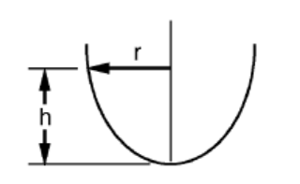

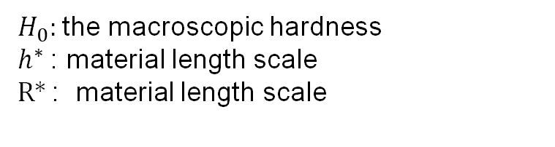
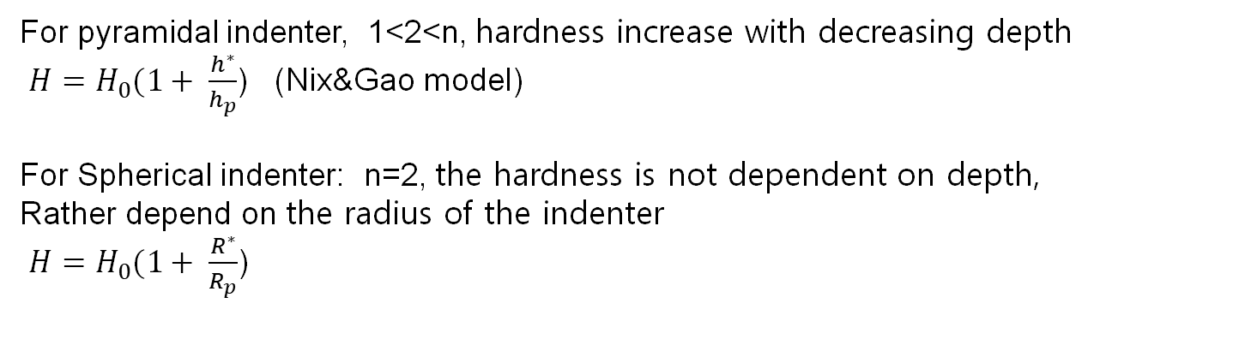
The correlation of the indentation size effect measured with indenters of various shapes (J.G. Swadener 2002)
h=Ar^{n}
For pyramidal indenter, 1<2<n, hardness increase with decreasing depth
${H=H}_{0}(1+ \frac{h^{∗}}{h_{p}}$) (Nix&Gao model)
For Spherical indenter: n=2, the hardness is not dependent on depth,
Rather depend on the radius of the indenter
${H=H}_{0}(1+ \frac{R^{∗}}{R_{p}}$)
$H_{0}:$the macroscopic hardness
$h^{∗}$: material length scale
R* : material length scale
1

Slide 2
The correlation of the indentation size effect measured with indenters of various shapes (J.G. Swadener 2002)
For pyramidal indenter:
2

Slide 3
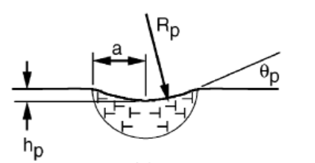
The correlation of the indentation size effect measured with indenters of various shapes (J.G. Swadener 2002)
For spherical indenter:
For a/R<0.03, the hardness increases due to transition from elastic to plastic regime
For a/R>0.03, the hardness increases due to work hardening
Hardness decrease with increasing indenter radius (Comparison of hardness at
same a/R to avoid influence of work hardening)
3

Slide 4
The correlation of the indentation size effect measured with indenters of various shapes (J.G. Swadener 2002)
For spherical indenter:
Correlation of hardness of Berkovich and Spherical indenter :
At Rp=5.2hp, the hardness should be the same
(offset of 1.2 GPa for Berkovich causedby the different effective strain used
for evaluated of hardness values)
4

Slide 5
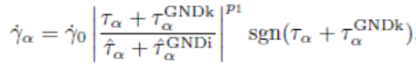
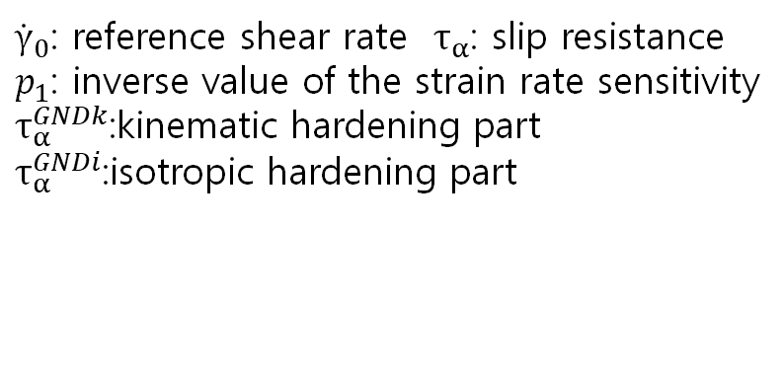
Indentation size effects in spherical nanoindentation analyzed by experiment and non-local crystal plasticity (J. K. Engels,2018)
A non-local crystal plasticity model is applied for investigate of the indentation size effect of
spherical indenter (incorporated with GND)
${\dot{γ}}_{0}$: reference shear rate $τ_{α}$: slip resistance
$p_{1}$: inverse value of the strain rate sensitivity
$τ_{α}^{GNDk}$:kinematic hardening part
$τ_{α}^{GNDi}$:isotropic hardening part
5

Slide 6
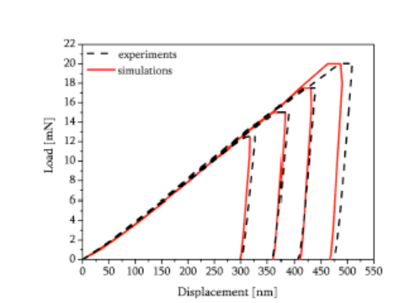
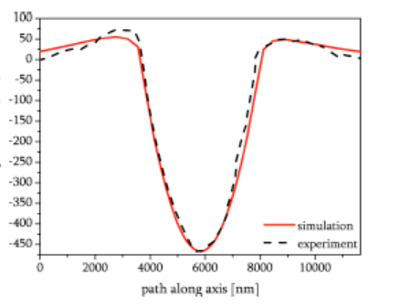
Indentation size effects in spherical nanoindentation analyzed by experiment and non-local crystal plasticity (J. K. Engels,2018)
The crystal parameters were adapted to fit both load-displacement curves and
residual surface topologies
6

Slide 7
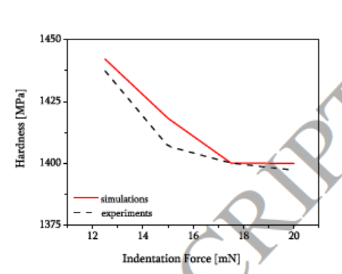
Indentation size effects in spherical nanoindentation analyzed by experiment and non-local crystal plasticity (J. K. Engels,2018)
ISE is observed as with decreasing indentation load the hardness increases
The hardness were calculated with
the help of Oliver & Pharr method
8

Slide 8
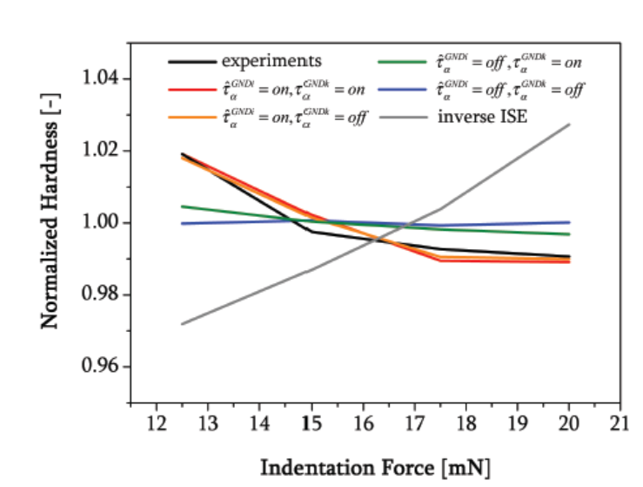
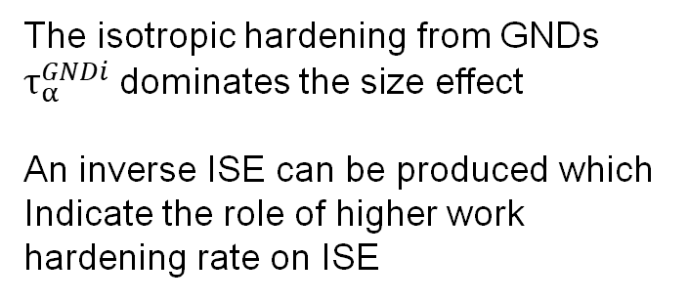
Indentation size effects in spherical nanoindentation analyzed by experiment and non-local crystal plasticity (J. K. Engels,2018)
The isotropic hardening from GNDs $τ_{α}^{GNDi}$ dominates the size effect
An inverse ISE can be produced which
Indicate the role of higher work
hardening rate on ISE
1

Slide 9
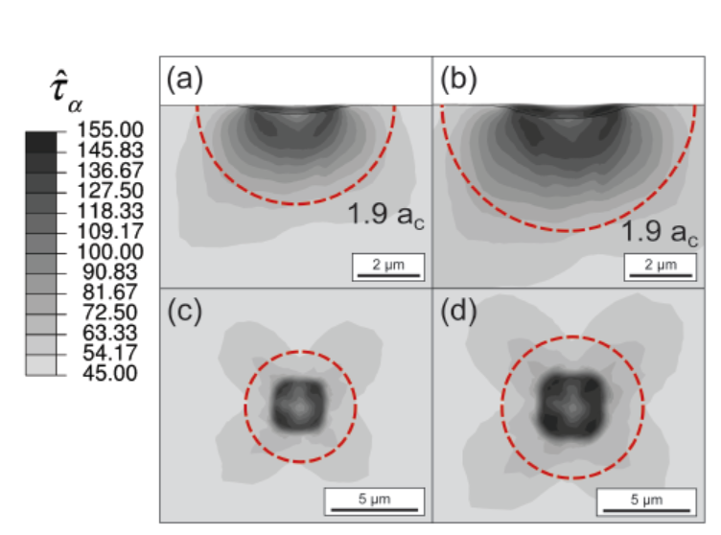
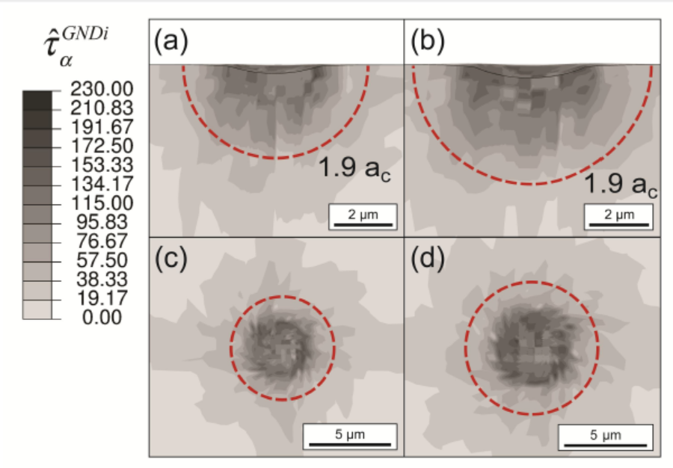
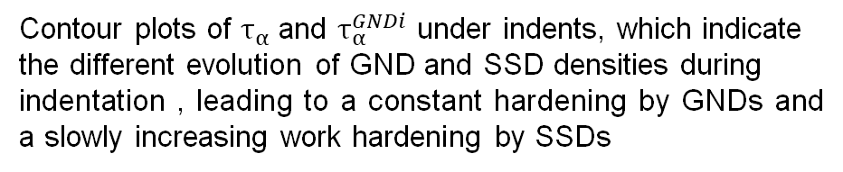
Indentation size effects in spherical nanoindentation analyzed by experiment and non-local crystal plasticity (J. K. Engels,2018)
Contour plots of $τ_{α}$ and $τ_{α}^{GNDi}$ under indents, which indicate
the different evolution of GND and SSD densities during
indentation , leading to a constant hardening by GNDs and a slowly increasing work hardening by SSDs
9

Slide 10
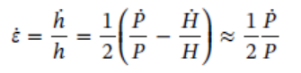
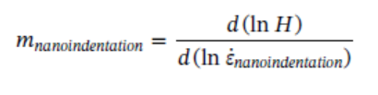
Mechanical characterization and strain-rate sensitivity measurement of Ti-7333 alloy based on nanoindentation and crystal plasticity modeling (M.Q Zhang, 2018)
To investigate the deformation mechanism of grains with different orientations
and strain-rate sensitivity of near β titanium alloy, nanoindentations are applied.
The results are compared with CPFEM simulation results for better understanding
of mesoscopic mechanical behavior.
Nanoindentation strain rate:
Nanoindentation strain rate sensitivity exponent:
10

Slide 11
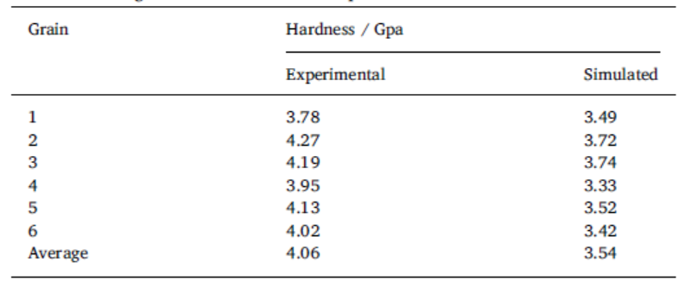
Mechanical characterization and strain-rate sensitivity measurement of Ti-7333 alloy based on nanoindentation and crystal plasticity modeling (M.Q Zhang, 2018)
The hardness shows a obvious
orientation-dependent characteristics.
Same results observed in simulation results.
11

Slide 12
Mechanical characterization and strain-rate sensitivity measurement of Ti-7333 alloy based on nanoindentation and crystal plasticity modeling (M.Q Zhang, 2018)
Different hardness under each
constant strain rate, the higher
strain rate it applies, the larger
hardness it obtains.
No obvious difference in hardness under the same strain rate, the
strain rate has more significant
influence than grain orientations.
12

Slide 13
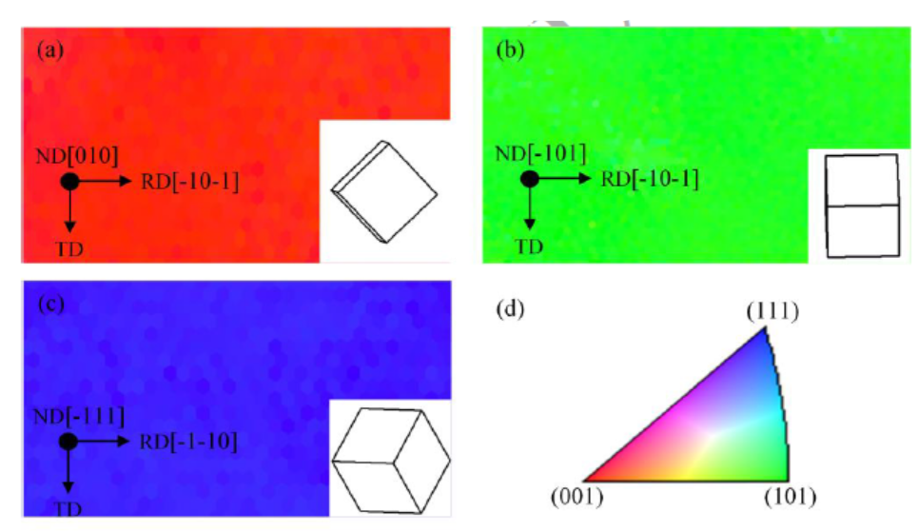
Coupled effect of crystallographic orientation and indenter geometry on nanoindentation of single crystalline copper (Z.F Wang, 2018)
Simulation results of CPFEM shows that there is a coupled effect of
crystallographic orientation of indented material and indenter geometry on surface pile-up behavior.
Three grains with different
grain orientations are tested
with Berkvoich indenter.
13

Slide 14
Coupled effect of crystallographic orientation and indenter geometry on nanoindentation of single crystalline copper (Z.F Wang, 2018)
Young’s modulus and Hardness is different for varied crystallographic orientations
For Cu(010): a triangular residual impression remained on the indented surface,
the height of surface pile-up along TD direction.
14

Slide 15
Coupled effect of crystallographic orientation and indenter geometry on nanoindentation of single crystalline copper (Z.F Wang, 2018)
For spherical tips, the activated slip systems
For (010) leads to the formation of four-fold symmetry of surface pile.
However, the shape of contact area around
the Berkvoich indenter is an equilateral
triangle that has a specific pattern with a
three-fold symmetry
15

Slide 16
Coupled effect of crystallographic orientation and indenter geometry on nanoindentation of single crystalline copper (Z.F Wang, 2018)
The coupled effect of activated slip systems and indenter geometry leads to the two folder pile up and three folder pile up for (110)
and (111) orientation respectively.
16

Slide 17
Coupled effect of crystallographic orientation and indenter geometry on nanoindentation of single crystalline copper (Z.F Wang, 2018)
Pile-up density factor: m_{p}=cos(α)cos(β)cos(ϒ)
The value of m_{p} ranges from 0 to 1, and a higher value indicates a higher surface pile-up height
17

Slide 18

Crystal plasticity finite element method modelling of indentation size effect (M Liu, 2015)
Description of ISE-Meyer’s law:
P=C$d^{n}$􀭬
P: load
d: diagonal length of impression
C: material/indenter constant
n：Meyer index
18

Slide 19
Crystal plasticity finite element method modelling of indentation size effect (M Liu, 2015)
The simulated load-displacement curve has been divided into two separate parts (0-110nm and 110nm-2000 nm) and fitted by two power relationships with different n value. The hardness calculated from the power laws shows
that hardness significantly decreases with the indentation depth
19

Slide 20
Crystal plasticity finite element method modelling of indentation size effect (M Liu, 2015)
Figure above shows shear strain rates of 12 slip systems for the same
selected element below the indenter tip.
Four slip systems were activated at the beginning of the indentation,
another two slip systems became active for indentation depth of
100-200 nm
20

Slide 21
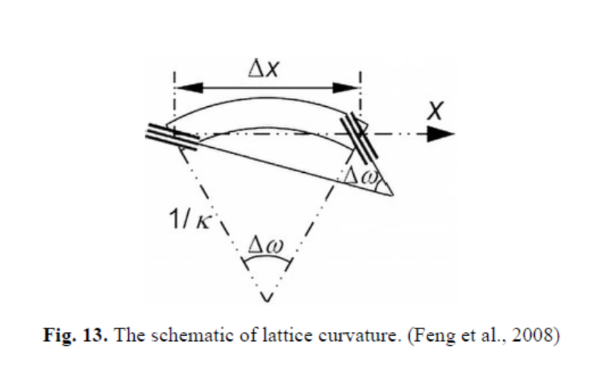
Crystal plasticity finite element method modelling of indentation size effect (M Liu, 2015)
The main lattice curvature k21 decreases with
the indentation depth from Stage A to Stage C
21

Slide 22
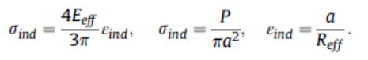
Correlation of spherical nanoindentation stress-strain curves to simple compression stress-strain curves for elastic-plastic isotropic materials using finite element models (Dipen K. 2016)
Relating of indentation stress-strain (ISS) curves with the conventional simple
compression tests is possible by applying a constraint factor.
a: the contact radius
P: load
Reff: effective radius
Eeff: effective modulus
i.e. Tabor model: for spherical indenter, the mean pressure scaled by a constraint factor of 2.8 when plotted against 0.2a/Ri produces an excellent
match with the simple compression stress-strain
curves
22

Slide 23
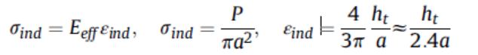
Correlation of spherical nanoindentation stress-strain curves to simple compression stress-strain curves for elastic-plastic isotropic materials using finite element models (Dipen K. 2016)
A 2D FE model was used for simulation of ISS
Curve.
The indentation strain and stress are defined as:
23

Slide 24
Correlation of spherical nanoindentation stress-strain curves to simple compression stress-strain curves for elastic-plastic isotropic materials using finite element models (Dipen K. 2016)
Scaling of ISS with constraint factor
of 2.2 for the elastic-perfectly plastic
sample
The elastic-plastic transition in the
ISS curve poses a significant
challenge
24

Slide 25
Correlation of spherical nanoindentation stress-strain curves to simple compression stress-strain curves for elastic-plastic isotropic materials using finite element models (Dipen K. 2016)
Scaling of ISS for the samples with
different levels of constant strain
hardening rates h0 by applying simple
scaling factor between indentation
plastic strain and the uniaxial plastic
strain
25

Slide 26
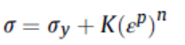
Correlation of spherical nanoindentation stress-strain curves to simple compression stress-strain curves for elastic-plastic isotropic materials using finite element models (Dipen K. 2016)
FE simulations with samples whose plastic
response described by power-law hardening as
The ISS and USS curves for the selected materials are compared with simple scaling
Factors, which are highly applicable to both high and low hardening behaviors
26

Slide 27
Indentation size effects of ferritic/martensitic steels: A comparative experimental and modelling study (Ana Ruiz-Moreno 2018)
Two main reasons for possible deviations of nano-indentation
hardness results from the Nix−Gao model:
A perfectly sharp indenter cannot be realized. A finite indenter tip radius will result in smaller indentation hardness values
The GNDs are not distributed uniformly in a hemisphere of
radius a
27

Slide 28
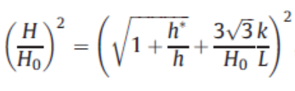
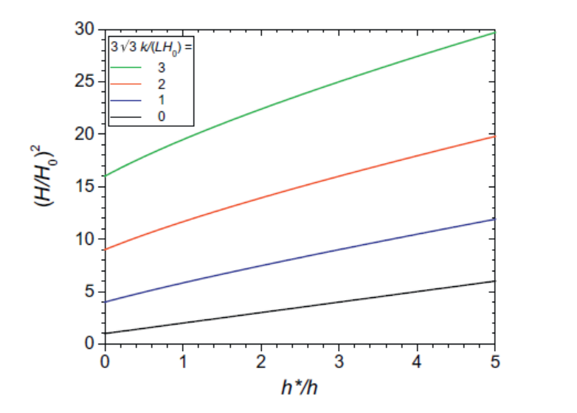
Indentation size effects of ferritic/martensitic steels: A comparative experimental and modelling study (Ana Ruiz-Moreno 2018)
For the first deviation:
Modification of hardness expression by
L: characteristic length scale
K: strengthening coefficient
Result for different k/L value.
k/L=0 indicates Nix-Gao model
28

Slide 29
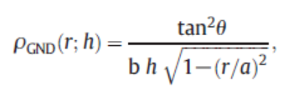
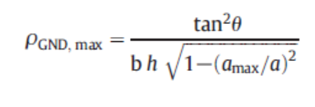
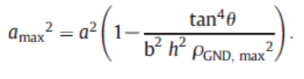
Indentation size effects of ferritic/martensitic steels: A comparative experimental and modelling study (Ana Ruiz-Moreno 2018)
For the second deviation:
Considering the dislocation density by polar coordinates
Introduce a cut-off of the GND density : ρ_{GND, max} and a_{max}
29

Slide 30
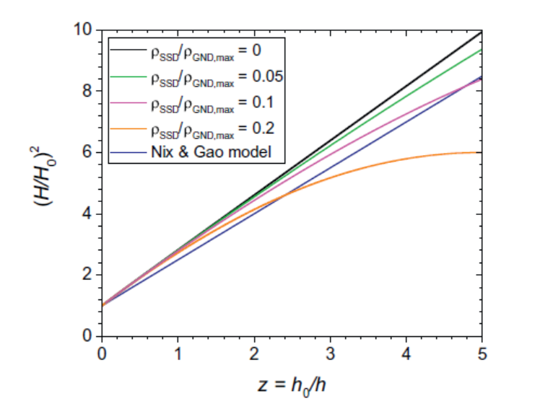
Indentation size effects of ferritic/martensitic steels: A comparative experimental and modelling study (Ana Ruiz-Moreno 2018)
For the second deviation:
Results after introducing a
ρ_{GND, max}
30

Slide 31
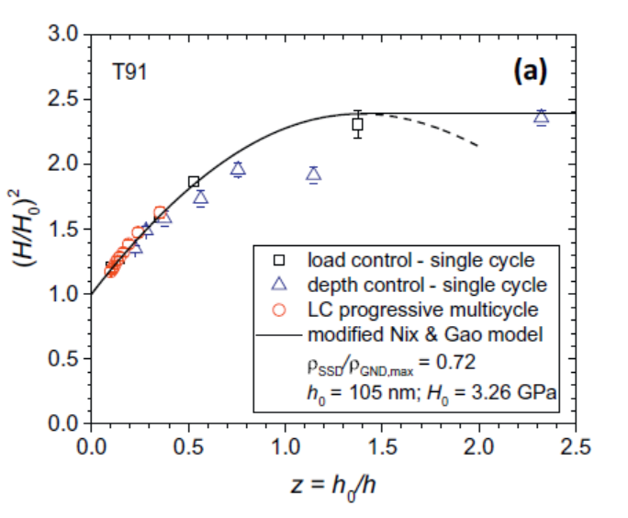
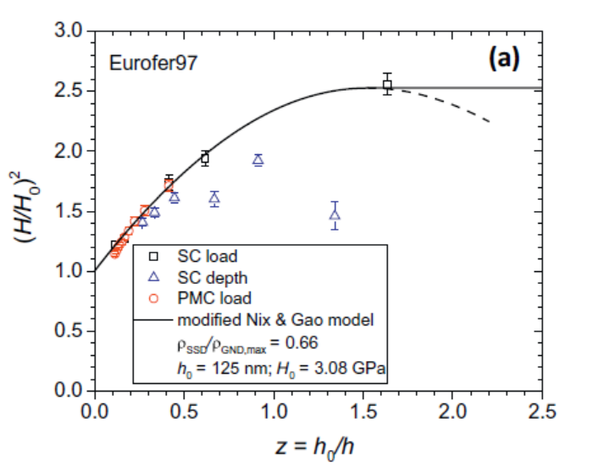
Indentation size effects of ferritic/martensitic steels: A comparative experimental and modelling study (Ana Ruiz-Moreno 2018)
Results of experiments and modified Nix-Gao model
31

